Slide 1
VIX - Timing the Market
Copyright©2022 JYL Consulting Incorporated Business Unlimited LLC.
Joe Geoghegan
Laramie Dunlap
Ying Fu
Notes:
Ying
Our presentation is using the Volatility Index
Go-He-Gen

Slide 2
Overview
Max.Profit
Timing the Market
Historical S&P 500
VIX
Investment Strategy
Notes:
Ying
The goal of our project is using a Volatility Index to time the market further maximizing profit. By analyzing historical market data at different periods of volatility - we have created an investment strategy to maximize profits.
and creating filtering models using modified Monte Carlo simulations,

Slide 3
What is the VIX?
Chicago Board Options Exchange Volatility Index
Tracks implied volatility of puts and calls on the S&P 500
SPY
Notes:
Laramie
The VIX is a volatility index that measures the implied volatility of S&P 500 options. Implied volatility can simply be thought of as Trader’s forecast of potential future movement

Slide 4
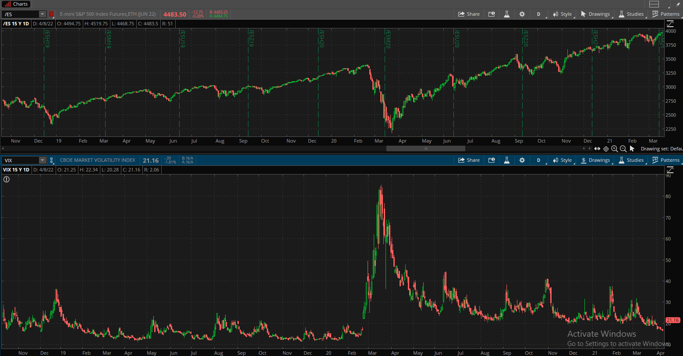
VIX spikes through 30
VIX @ 20
Notes:
Laramie
Looking at the S&P and the VIX, you can see that during a bull run (click), implied volatility remains low. But during, for instance, a global pandemic, (click) implied volatility explodes higher. Presently, volatility (click) is just now beginning to return to pre-pandemic levels.

Slide 5
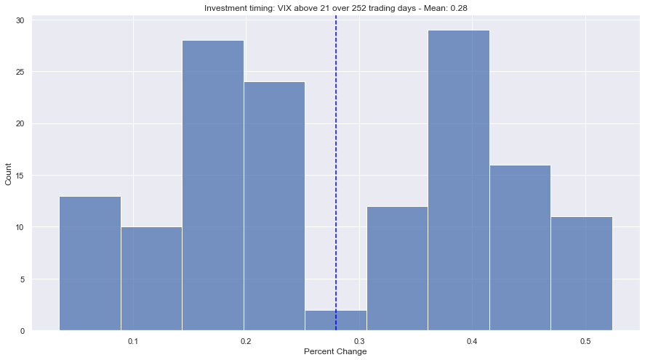
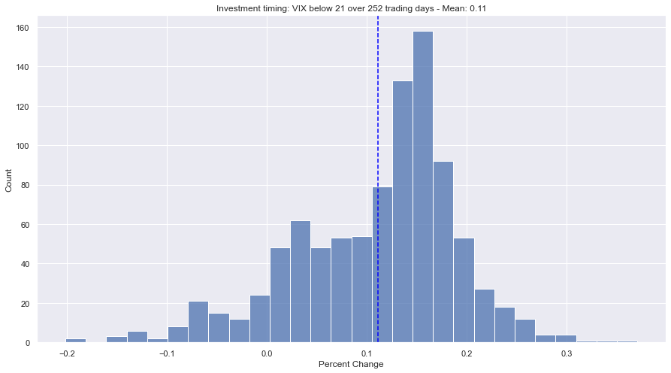
11% annual
return
40% annual return
20% annual return
Notes:
Ying
When investing in the S&P 500 while the VIX is below 21, the expected return is positively skewed and centered at 11%. However, buying the S&P 500 when the VIX elevates above 21 leads to a bimodal return centering around an expected 20% return or 40%.

Slide 6
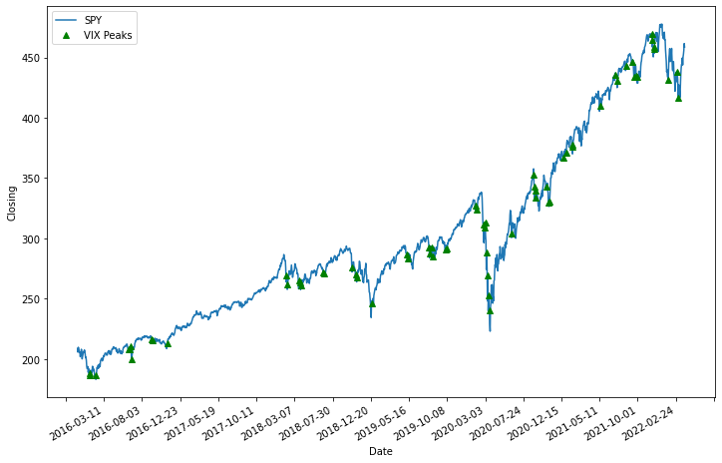
Why is High Volatility Bimodal?
Notes:
Joe
VIX peaks occur typically at the beginning or end of a bear trend, buying at the beginning of a bear trend would have less returns then buying at the end of a bear trend. Since spikes occur rapidly this causes this bimodal behavior

Slide 7
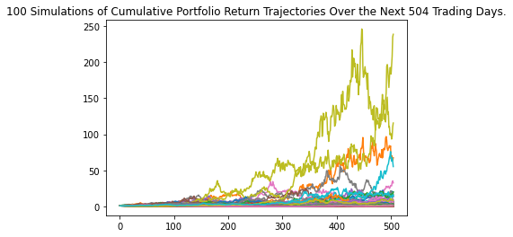
Can Volatility Index be accurately simulated?
MonteCarlo Simulation of “i”
i
Notes:
Laramie

Slide 8
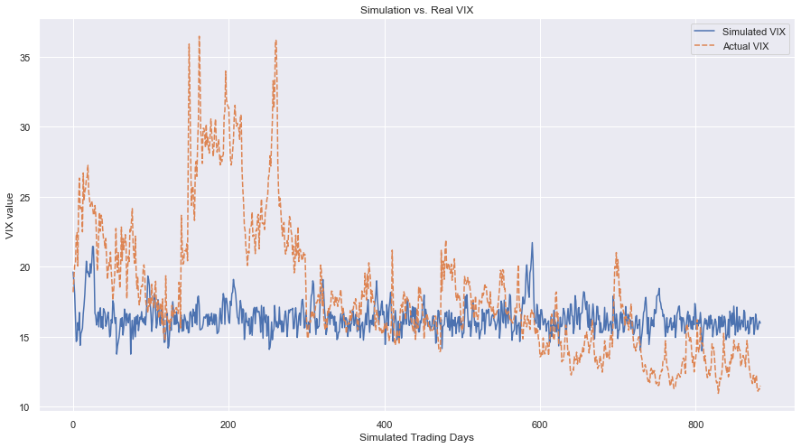
Can Volatility Index be accurately simulated?
Markov Chain Monte Carlo
i
Notes:
Laramie

Slide 9
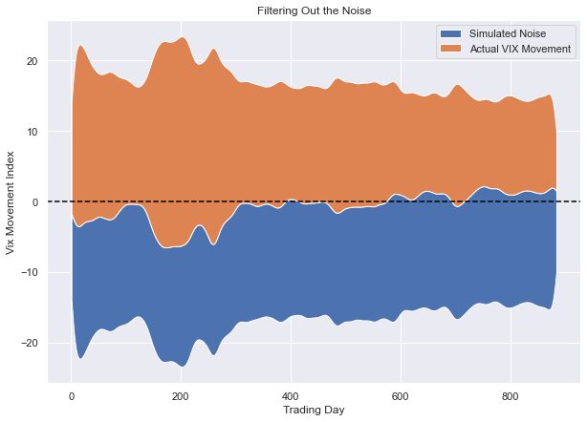
Finding a Signal
Composed
Notes:
Laramie

Slide 10
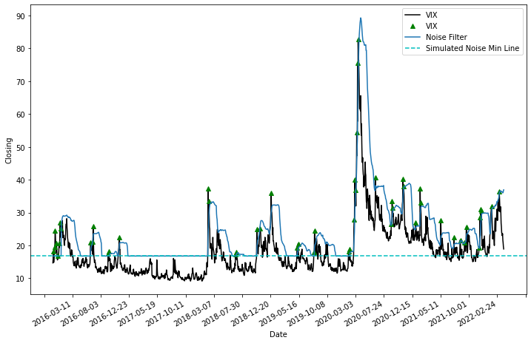
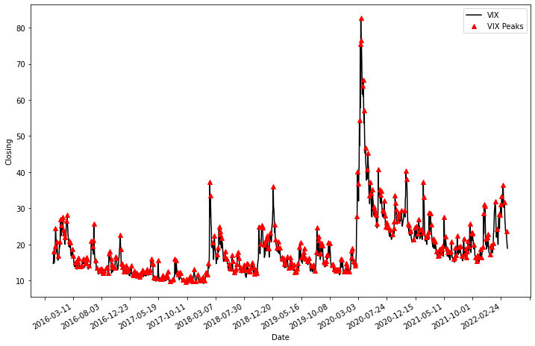
The Peaks of the VIX
Average number of days between Peaks is 35 Calendar Days
Notes:
Joe
Here shows all the peaks in the VIX, this is far too much noise and unusable so we filtered
*
the peaks down using Laramie’s simulated noise as well as using rolling mean and standard deviation. Using these techniques we were able to better capture the significant peaks of the VIX
*
One of the first things we look at is the space between these peaks, we see, on average the number of days between peaks is 30 Calendar Days

Slide 11
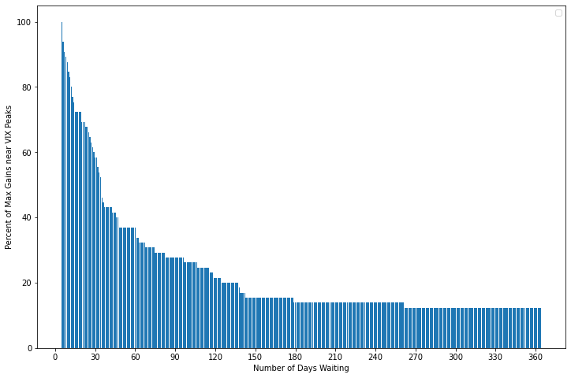
Strategy to use the VIX to Time the Market
How long should I wait?
VIX Peaks historically happen within 100 Days of the last peak
30 Trading Sessions
Notes:
Joe
This chart is powerful but I need to unpack it a little bit. On the X axis
*animate arrow pointing to X label
it shows the number of days you are waiting for a VIX peak which you know will contain some price of the S&P that will get you a 2 to 4 times better return. On the Y axis
* this is the percent chance, THE ODDS, of you getting that best price price within your waiting period.
So if I go to the far left of this graph, waiting a minimal time until till I see a peak. Of course, when you immediately find yourself seeing a spike in the VIX, the fall in the S&P will be your best price. As you expand the window you have waited until you see a VIX peak - the odds of the next VIX peak being significant enough to be a better investment than an earlier one decreases. So as you get to an expanded window of, say, a year, you need a VIX spike like the pandemic to make the time you waited worth it.
*So how long should you wait?
*The steepest decline in your odds of getting your optimal S&P price occurs over the 1 month.
*With the critical drop right around the end of a month
Since you can expect the next peak to happen within 35 calendar days of the last, long term investors should
* wait 30 trading sessions from the last peak maximizes your odds of buying the best price given the natural rise of the S&P

Slide 12
Strategy:
Higher VIX, Better Discount
20% annual return > 11%

Slide 13
2) A one month waiting period maximizes odds

Slide 14
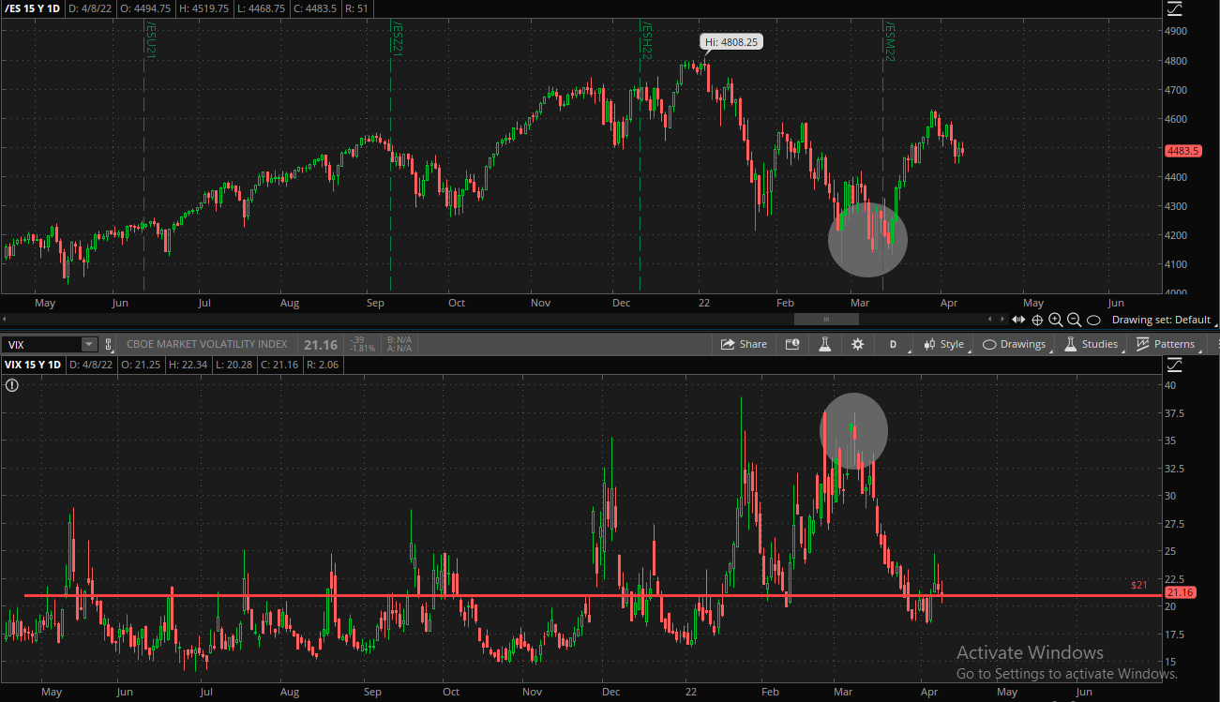
3) Align your investment time frames
Prior Peak: March 8th, 2022
Expected Spike: April 10-16th

Slide 15
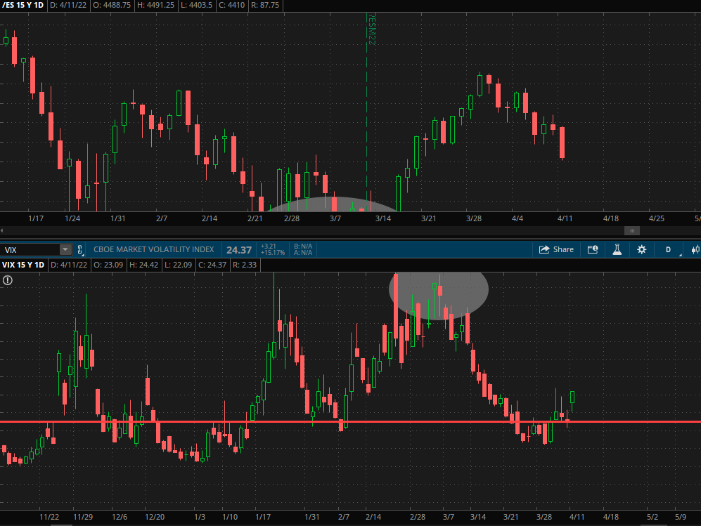
S&P -1.64%
VIX up 15% 4/11/2022

Slide 16
Thank you!
Questions?

